Slide 1

Department of Computer Science &Engineering Artificial Intelligence & Machine Learning
A.P. Shah Institute of Technology G.B.Road,Kasarvadavli, Thane(W), Mumbai-400615
UNIVERSITY OF MUMBAI
Academic Year 2023-2024

Slide 2
TASK MANAGER
Computer Science & Engineering Artificial Intelligence and Machine Learning
By
Akash Singh(22106065)
Aditya Rawat(22106022)
Yuvraj Tiwari (22106061)
Under the Guidance of Prof. Sayali Badhan

Slide 3
Index
Introduction
Objectives
Features
Literature survey
Block Diagram
Tools/Softwares, Languages used
Implementation
Conclusion
References

Slide 4
Introduction
The Task Manager project is a software application designed to redefine task management for individuals.
In a fast-paced world, where juggling multiple responsibilities is the norm, this project aims to provide a user-friendly solution for organizing, prioritizing, and executing tasks efficiently.
By leveraging modern technology and innovative design, this project aspires to transform the way users manage their daily responsibilities and boost their productivity.

Slide 5
Objective
The Task Manager project is dedicated to offering individual users a highly efficient and user-friendly task management tool.
Its core purpose is to streamline task tracking, enhance time management skills, and foster personal growth and productivity.
By prioritizing user-centric design, this project aims to create an indispensable tool that empowers users to not only accomplish their goals and reduce stress but also to strike a harmonious work-life balance.
It seeks to be the go-to solution for individuals seeking to excel in their personal and professional endeavors.

Slide 6
FEATURES
1) Task Searching - The robust search functionality enables users to quickly locate specific tasks, whether by keywords, tags, or filters. This feature ensures that users can effortlessly retrieve tasks, even from large task lists. 2) Delete Task
- The "Delete Task" feature allows users to remove a selected task from
the to-do list, helping maintain an organized and up-to-date task list. 3)Task Priority - Users can assign priority levels to tasks, ensuring they concentrate on the most important and time-sensitive activities. This feature empowers users to make better decisions about where to direct their efforts.

Slide 7
4)Task Reminders - Never miss a deadline or forget an important task again with the task reminders feature. Users can set reminders for each task, keeping them on track and accountable.
5)Dashboard - The dashboard provides a holistic view of task completion, highlighting completed tasks and emphasizing the next priority task. It serves as a central hub for managing tasks effectively.

Slide 8
LITERATURE SURVEY
1. Introduction to Task Management: - Define the significance of task management in personal and professional life. - Highlight the need for efficient task management tools. 2. Existing Task Management Tools: - Review popular task management software. - Summarize key features and user experiences. 3. Productivity Methods and Tools: - Discuss productivity methodologies like GTD and task prioritization. - Explore tools and techniques that enhance productivity.

Slide 9
5. User Feedback and Trends Trends: - Summarize user feedback and common pain points in task management tools. - Highlight emerging trends, such as AI-driven task prioritization. 6. Conclusion: - Sum up key findings. - Identify gaps in existing task management solutions. - Explain how your project aims to address these gaps and innovate in the field

Slide 10
BLOCK DIAGRAM

Slide 11
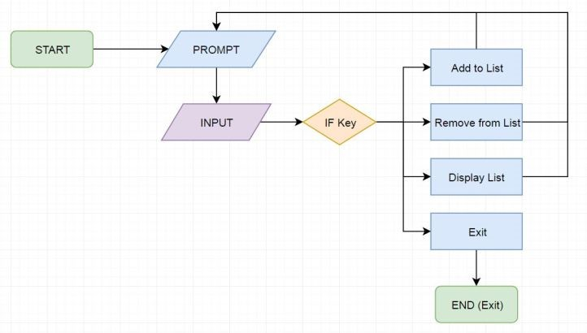

Slide 12
Block Diagram Implementation
The Task Manager project in Java offers a robust and versatile solution for efficient task management. This comprehensive application empowers users to perform a range of tasks, including task creation, deletion, search, prioritization, and reminders, all seamlessly integrated with a Java-based database.

Slide 13


Tools/softwares, Languages used
Java:
Java is a versatile and widely-used programming language known for its platform independence. It can be used for both web and mobile application development. Java Swing: Java Swing is a set of libraries and components for creating graphical user interfaces (GUIs) in Java. It’s suitable for building desktop applications with a graphical interface

Slide 14
PROJECT WORK

Slide 15
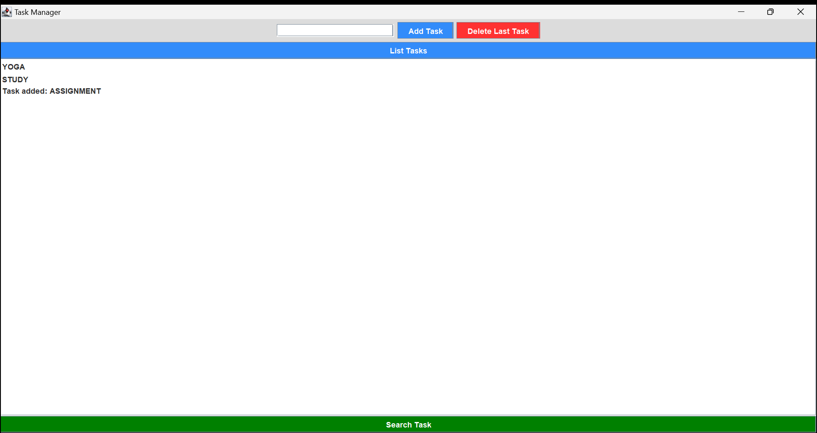
Implementation

Slide 16
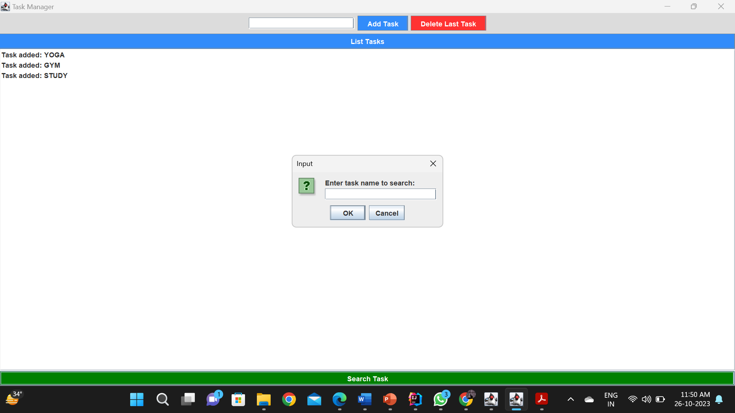

Slide 17
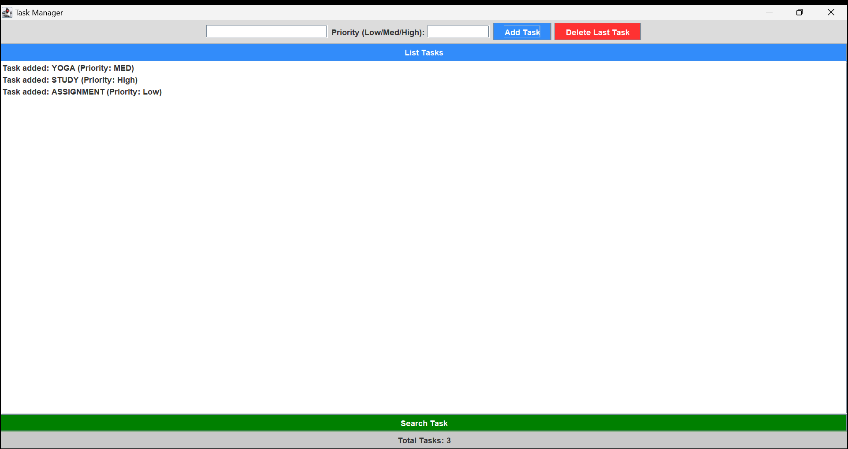

Slide 18
Conclusion
Task Manager project has reached a significant milestone, with 40% of the core development completed. We have successfully implemented three key features, and while the foundation is set, the next phase will focus on integrating these functionalities into a user-friendly GUI interface. Furthermore, several additional features are planned for future implementation, enhancing the project’s functionality and user experience. This ongoing dedication to improvement underscores our commitment to providing a robust task management solution for users.

Slide 19
References
Smith, J. (2022). Effective Task Management Strategies. Publisher Name. Johnson, A. (2021). The Importance of Time Management in Task Management. Journal of Productivity, 15(2), 123-145. Task Manager Pro. (2020). Retrieved from https://www.taskmanagerpro.com/ Brown, C. (2019). Task Management Best Practices. Task Management Journal, 8(3), 67-82.

Slide 20


Thank you

